Slide 1


Slide 2
1) What is the main lesson we highlight through
RECYCLEOLOGY website?
Recycling System
Flora & Fauna
Ecosystem
Pollution

Slide 3



2) Which is the waste that can be recycled based on the video?

Slide 4

3) Which is the waste that cannot be recycled based on the video?

Slide 5
4) Which one is not in category of 3R?
Reuse
Recycle
Remote
Reduce

Slide 6
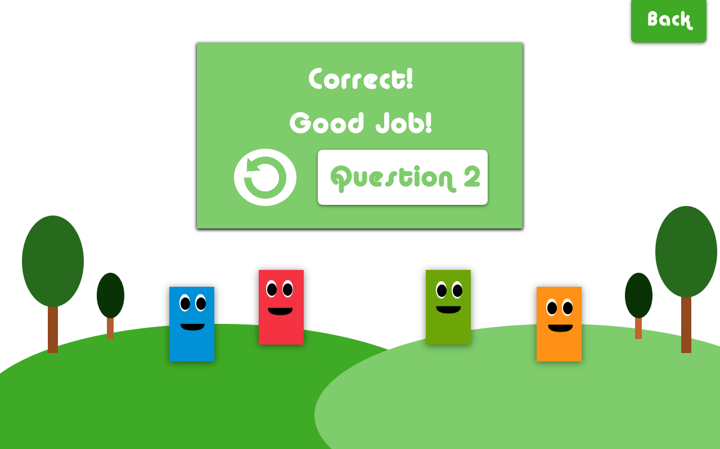
CORRECT
Great Job!
Replay
Question 2

Slide 7
CORRECT
Great Job!
Replay
Question 3

Slide 8
CORRECT
Great Job!
Replay
Question 4

Slide 9
CORRECT
Great Job!
Replay
Restart

Slide 10
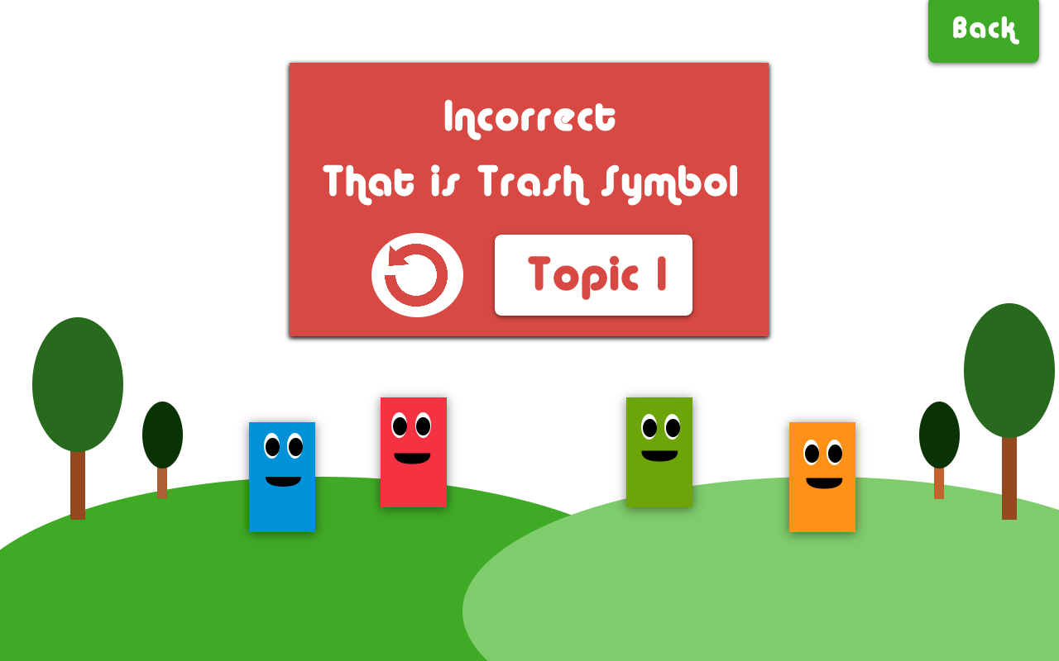
INCORRECT
Question 1
Try Again
Replay

Slide 11
INCORRECT
Question 2
Try Again
Replay

Slide 12
INCORRECT
Question 3
Try Again
Replay

Slide 13
INCORRECT
Question 4
Try Again
Replay

